Slide 1

Lending Club Loan Analysis
Maryland State Case

Slide 2
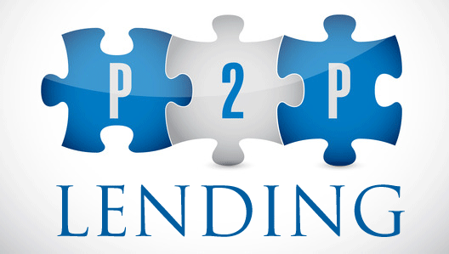
Capstone project overview
Identifying the business problem for Lending Club
Data description
Data preparation and processing
Data Analysis
        Nation wide Analysis
        Case of the State of Maryland
Models:
        Logistic Regression
        Ada Boost Classifier
        Gradient Boost Classifier
        Random Forest Tree
        Decision Tree Classifier
Summary of finding
Conclusion

Slide 3
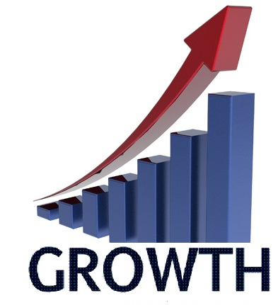
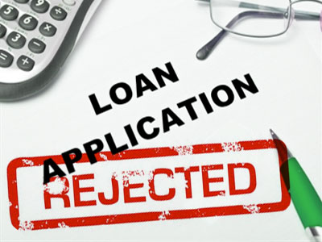
Business problem identification
Alt lenders often claim that their underwriting models are more accurate than legacy lenders because they use data from a wider range of sources.
Lending Club may be attracting people who don't intend to pay back loans.
Our business problem is to be able to expand the business model and to also flag bad applicants that can be a drag on the business model. This will help the investor maximize their profit.

Slide 4
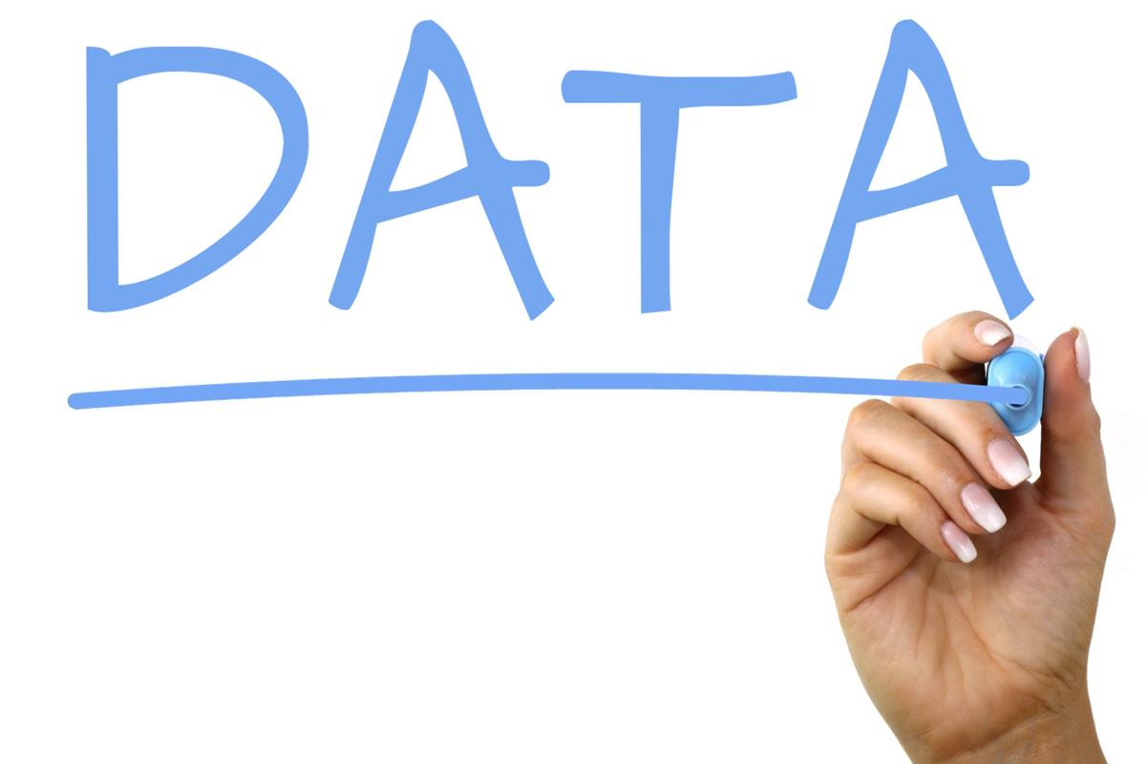
Data description
The data used for this project was downloaded from the Lending Club website. It comprised all the loan approved for 2012 and 2013.
The data contained 150 columns and 188183 applicants: most of the variable were generated after the loans were issued thus needed some good cleaning prior to the analysis and modeling.
We kept only most of the variables that existed prior of the loan issuance.

Slide 5
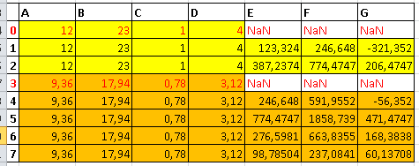
Data cleaning
Deleted column with variables that will affect the modeling
Deleted duplicated columns (different names but similar information)
Transformation of some data( removal of % signs)
Eliminating some row with missing values

Slide 6
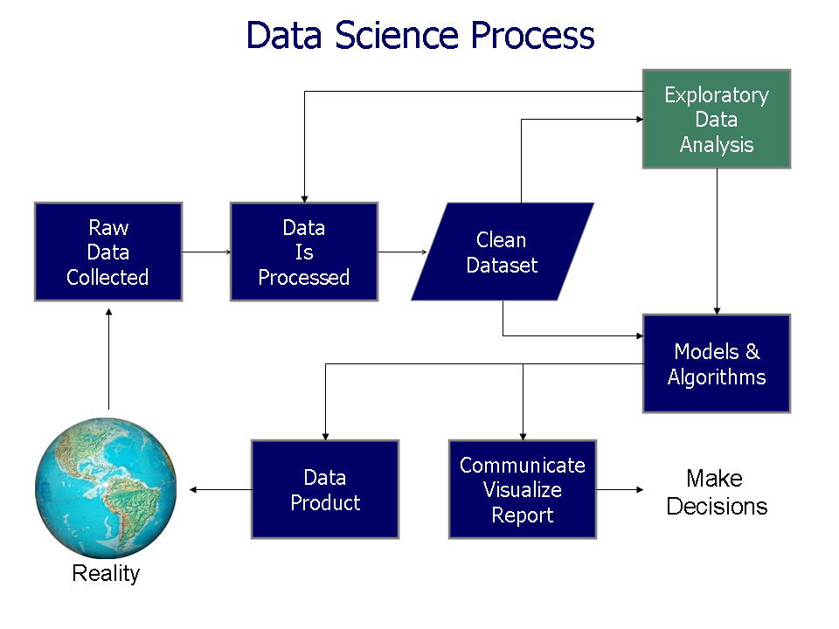
Data analysis
At the Nationwide level we were able to determine that the most populous State, California, actually come at the eighth position for number of borrowers per capita.
This imply that, the peers to peers lending is a Business model that still need to be expanded.
It is a Business model less harsh on the borrowers as are the pay days loan with higher interest rate some time not affordable at all to the common folks.
We also determined that people who have worked 10 years or more tend to borrow more
$10,000.00 was the amount of loan most borrowed

Slide 7
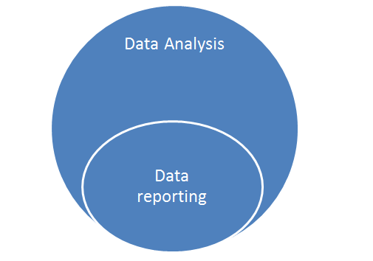
Data analysis(Continued)
We have found that the people with income in the middle tend to borrow more than top earners or lower earners. The explanation could be the fact that people with middle income try to mimic the life style of top earners, but their income is not enough to do that and they will borrow to accomplish that.
The State of Maryland broken down by county really mimic the trend nationwide with the same finding.
The other finding is that since people in the middle income tend to borrow more, they also tend to default more than any income category.

Slide 8
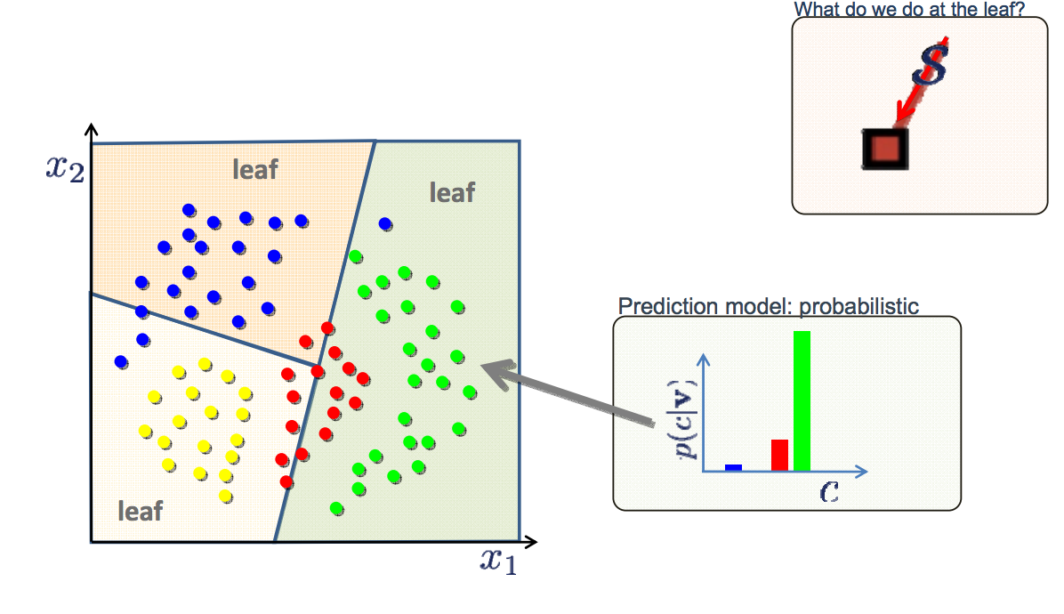
Models
We started with 5 different classifiers:
    Logistic Regression
    Decision Tree Classifier
    Ada Boost Classifier
    Gradient Boosting Classifier
    Random Forest Classifier
At the end we only used the last three classifiers because they gave us better results.

Slide 9
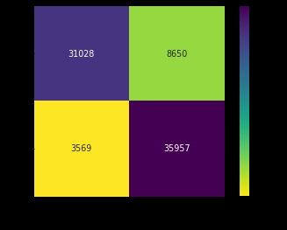
Modeling
    Using Ada Boost Classifier, Gradient Boosting Classifier, Random Forest Classifier on the imbalanced data(more loans paid off than default at the ratio of 84/16) none of the model was able to predict the minority at an acceptable level.
    After leveraging the default to the level of loan paid off, we have obtained better results with the three classifiers and Gradient Boosting Classifier ended up been the best of the three by been able to
    To predict correctly that 31028 loan will default

Slide 10
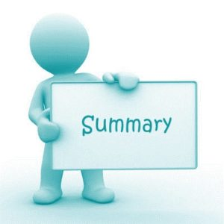
Conclusion
We were able to look into the Lending Club data and turn it in all side and get any type of information needed for our project: Loan per capita per State, average annual income per State.
We were also able to slice the State of Maryland and go County by County to see the repartition of the loan matched to the annual income.
We have notice that the trend at the Nationwide level appears to replicate it self at the local level: people in the middle income level tend to borrow more than any other category.
We have also classified all the borrower and were able to predict if a borrower will default or now.

